Slide 1
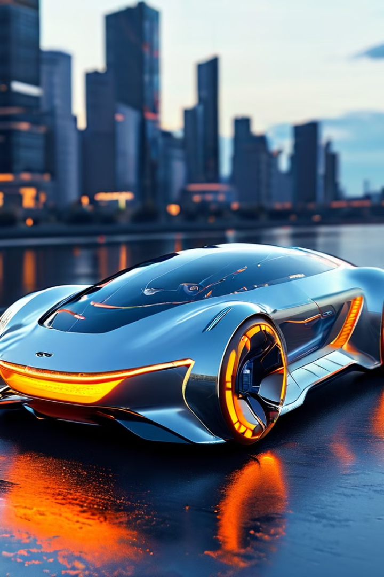
Vehicle Automation: CAN and IoT
This presentation explores the integration of CAN (Controller Area Network) bus technology and the Internet of Things (IoT) to enable advanced vehicle automation features, such as automated wipers and air conditioning control.
Presented by:
Gurram Chandu - 240340130018
Oindrilla Chakraborti - 240340130030
Shubham Pujari - 240340130047
Suhail Ok - 240340130048
Vipul Surte - 240340130052

Slide 2
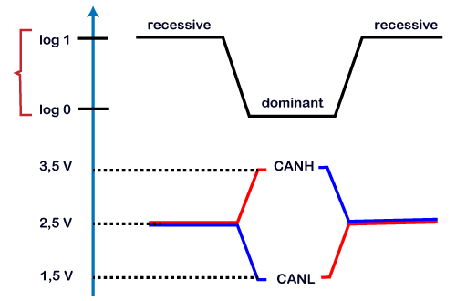

Introduction to CAN
Introduction to CAN
What is CAN?
What is CAN ?
MCU
CAN Controller
CAN_Tx
CAN_Rx
CANH
CANL
Fig: Differential Signals
Fig : A CAN Node

Slide 3
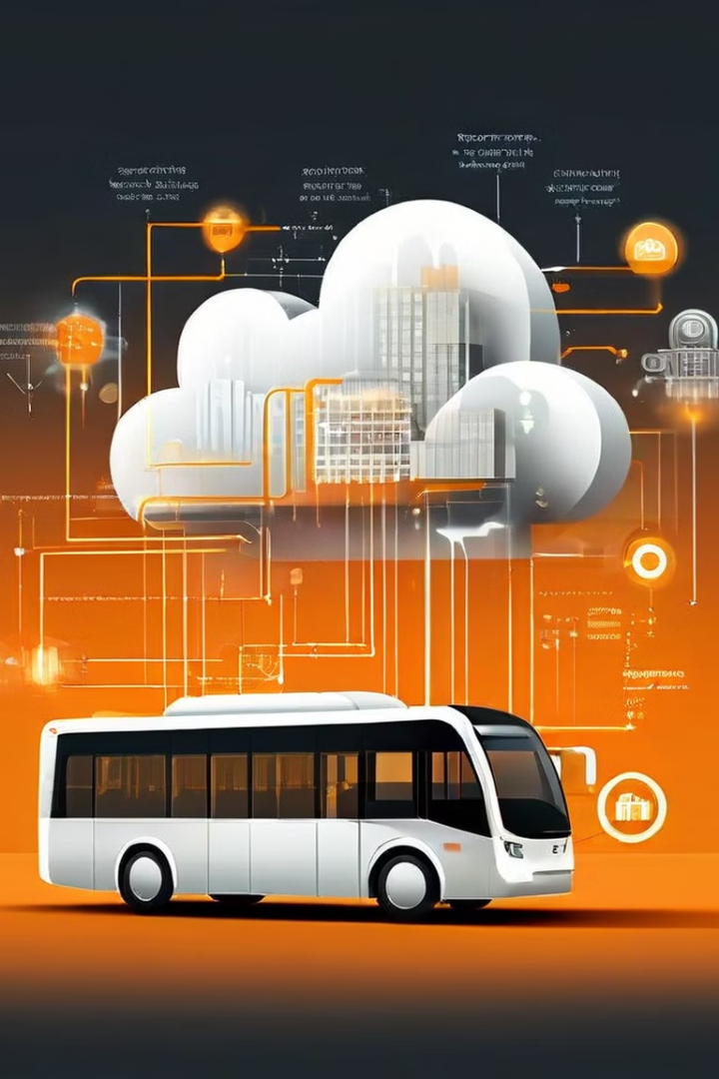



Integrating CAN with IoT
CAN Data Collection
IoT devices can be used to capture and transmit CAN bus data to the cloud for remote monitoring and analysis.
Cloud Processing
The collected CAN data can be processed in the cloud, enabling advanced analytics and predictive maintenance features.
Remote Monitoring
IoT integration allows for remote monitoring and automation of vehicle systems, such as wipers and air conditioning, through mobile apps or web interfaces.

Slide 4

Automating Wipers using CAN and IoT
Sensor Integration
Smart Scheduling
CAN-connected rain sensors can detect precipitation and trigger the wiper system to activate automatically.
IoT integration allows users to schedule wiper activation based on weather conditions, time of day, or personal preferences.
Remote Control
Adaptive Behavior
The wiper system can be controlled remotely through a mobile app or web interface, providing convenience and added safety.
The system can adjust wiper speed and interval based on the intensity of rainfall, ensuring optimal visibility.

Slide 5
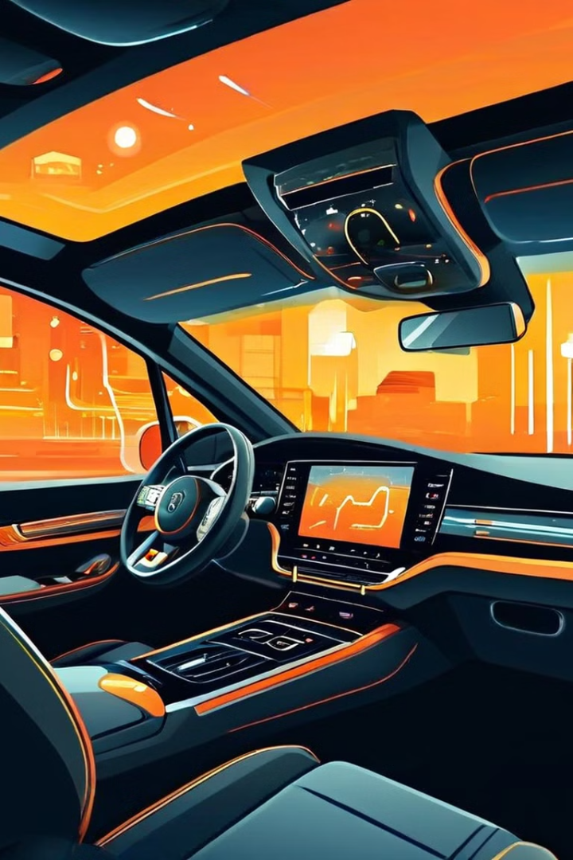




Automating AC using CAN and IoT
Temperature Monitoring
Automated Adjustment
CAN-connected sensors can detect the cabin temperature and relay this information to the IoT system.
The IoT system can then automatically adjust the air conditioning settings to maintain the desired temperature.
Remote Control
Energy Optimization
Users can also remotely control the AC system through a mobile app or web interface, providing added convenience.
The system can optimize energy usage by adjusting the AC based on factors like outdoor temperature and vehicle occupancy.

Slide 6
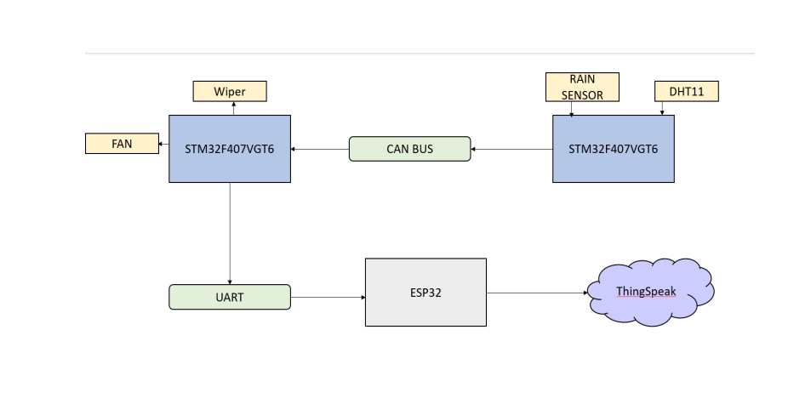
CAN Implementation

Slide 7
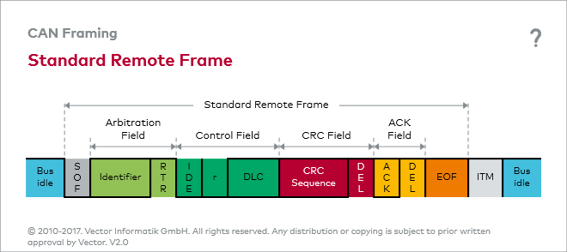

Slide 8
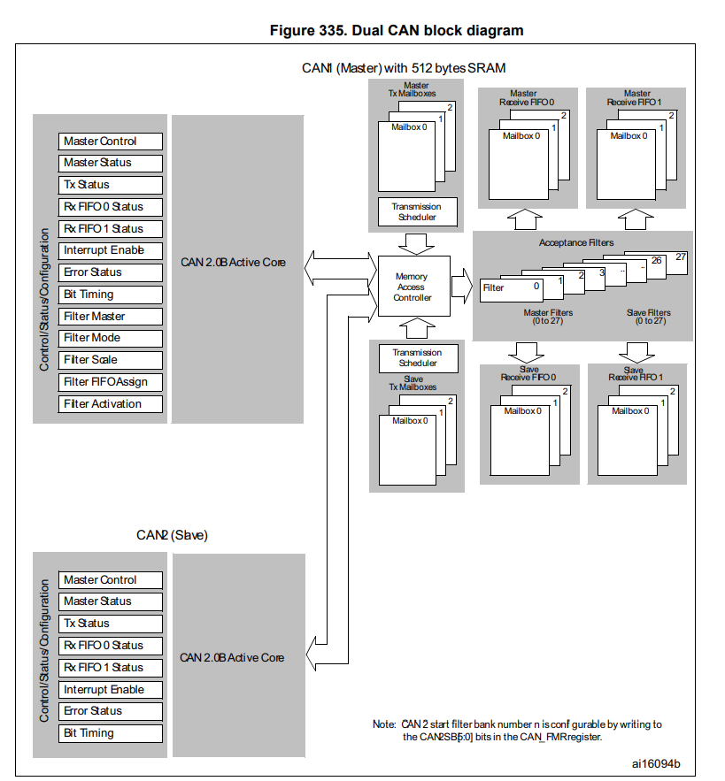

Slide 9
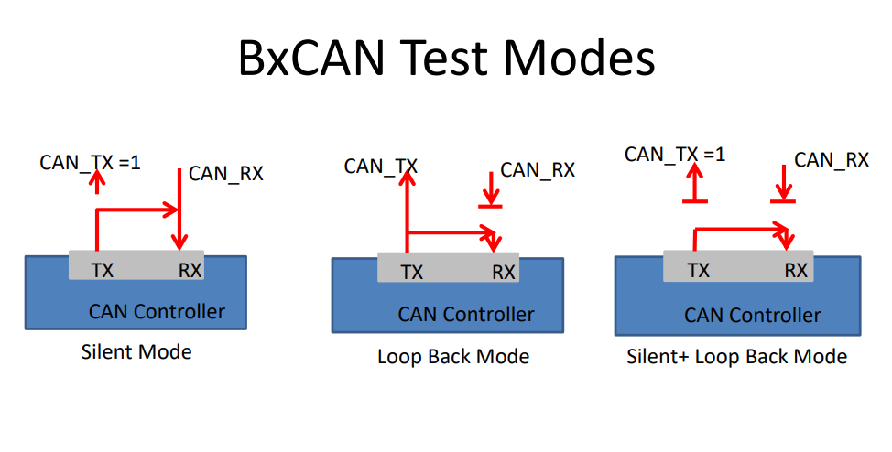

Slide 10
Components
DHT11: A low-cost temperature and humidity sensor used for climate control systems.
ESP32 : An IoT microcontroller board featuring WiFi and Bluetooth connectivity for seamless data transmission and processing. It can be used for implementing various automation and control applications in smart vehicles.
CAN Bus: A communication protocol used for transmitting data between vehicle components.
STM Microcontroller: A powerful and versatile microcontroller that can be used for controlling various vehicle systems, such as engine management and safety features.
Rain Sensor: A sensor that detects precipitation and can be used in automated windshield wiper systems to adjust the wiper speed based on rainfall intensity.
Step Motor: A type of electric motor that can be used in vehicle automation systems for precise control of movement, such as opening and closing doors or adjusting seat positions. It works by converting electrical pulses into precise angular rotation, allowing for accurate positioning of mechanical components.

Slide 11
DHT11
Integration of additional sensors such as the DHT11 and rainwater sensor can enhance the capabilities of vehicle automation systems. The DHT11 can provide temperature and humidity readings for improved climate control, while the rainwater sensor can help detect and respond to road conditions during inclement weather. This integration further expands the potential applications of IoT technology in vehicles. Moreover, the integration of these additional sensors can also contribute to the safety of vehicle automation systems. By monitoring temperature and humidity levels, the DHT11 sensor can aid in preventing foggy windshields and provide a comfortable driving environment. Additionally, the rainwater sensor can assist in detecting slippery road conditions, allowing the automation system to adjust the vehicle's handling and braking accordingly.

Slide 12

Rainwater Sensor and Stepper Motor: A Powerful Duo
An introduction to how rainwater sensors and stepper motors can be combined for smart irrigation systems.

Slide 13

How the Rainwater Sensor Works
1
Detecting Rain
2
Electrical Signal
The sensor uses a conductive material.
Rain creates a circuit.
3
Output Signal
4
Reliable Data
Indicates when it's raining.
Accurate and timely rain detection.

Slide 14
The Comparator Circuit
Comparator's Role
Sensor Input
Reference Voltage
Compares two input voltages.
Connected to the comparator's negative input.
Connected to the comparator's positive input.
Determines which voltage is higher.
Provides voltage information about rainfall.
Sets the threshold for the sensor.

Slide 15
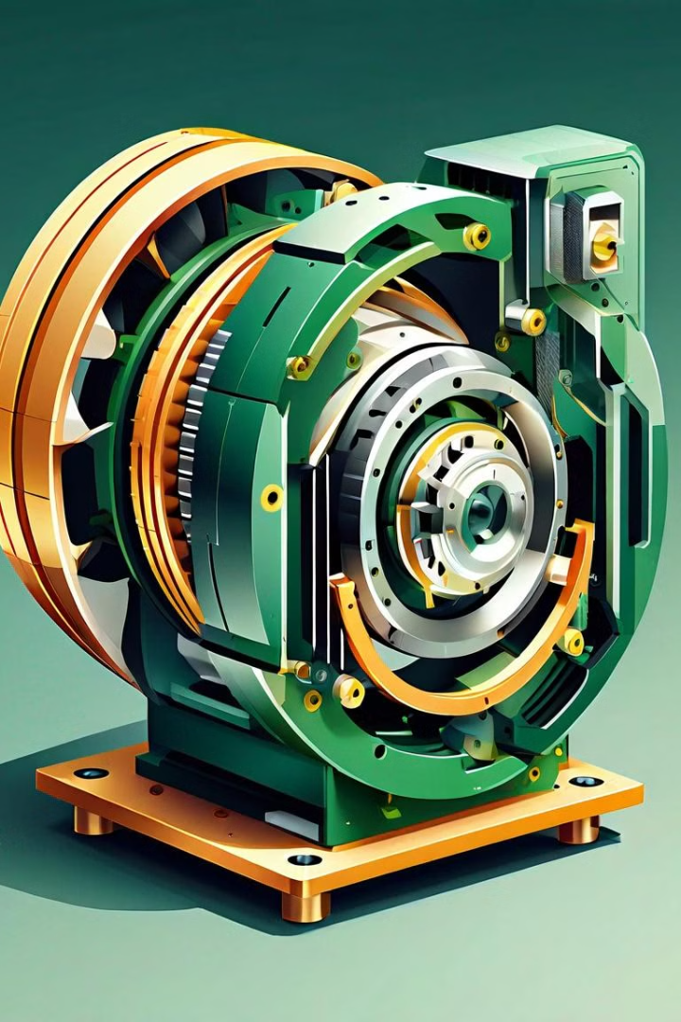



Stepper Motor: Principles and Applications
Precise Movement
Rotates in steps.
Digital Control
Controlled by electrical pulses.
Wide Applications
Used in robotics, automation.

Slide 16
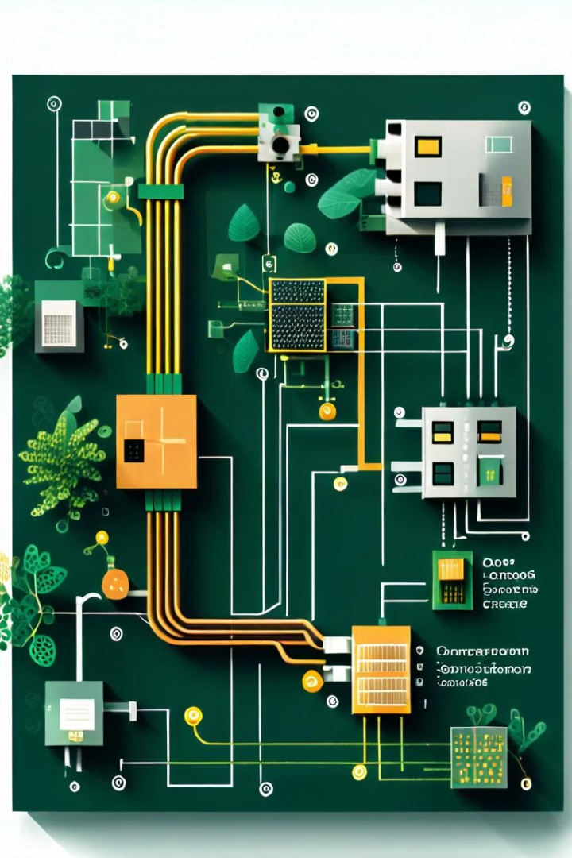
Controlling Stepper Motor with Rainwater Sensor
1
Rain Detection
The sensor sends a signal.
2
Comparator Evaluation
Determines if rain is above the threshold.
3
Stepper Motor Control
Motor rotates based on the signal.
4
Irrigation Activation
Automatic water flow is adjusted.

Slide 17
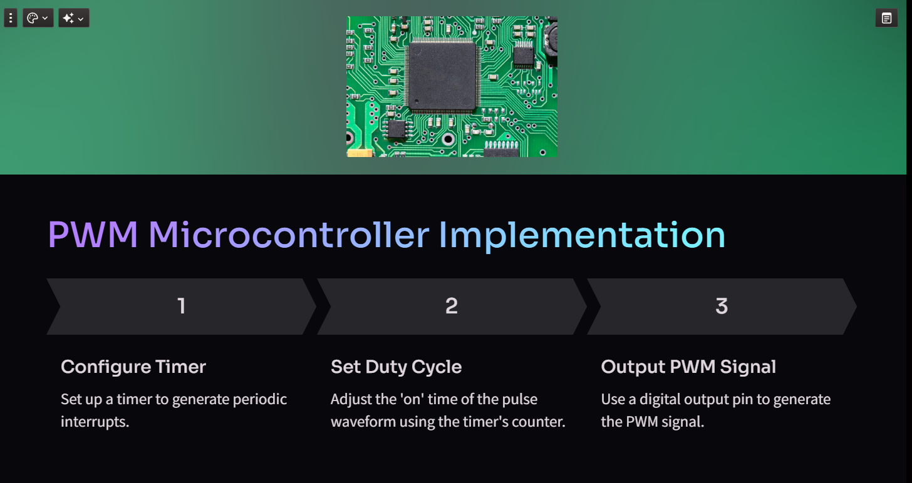

Slide 18
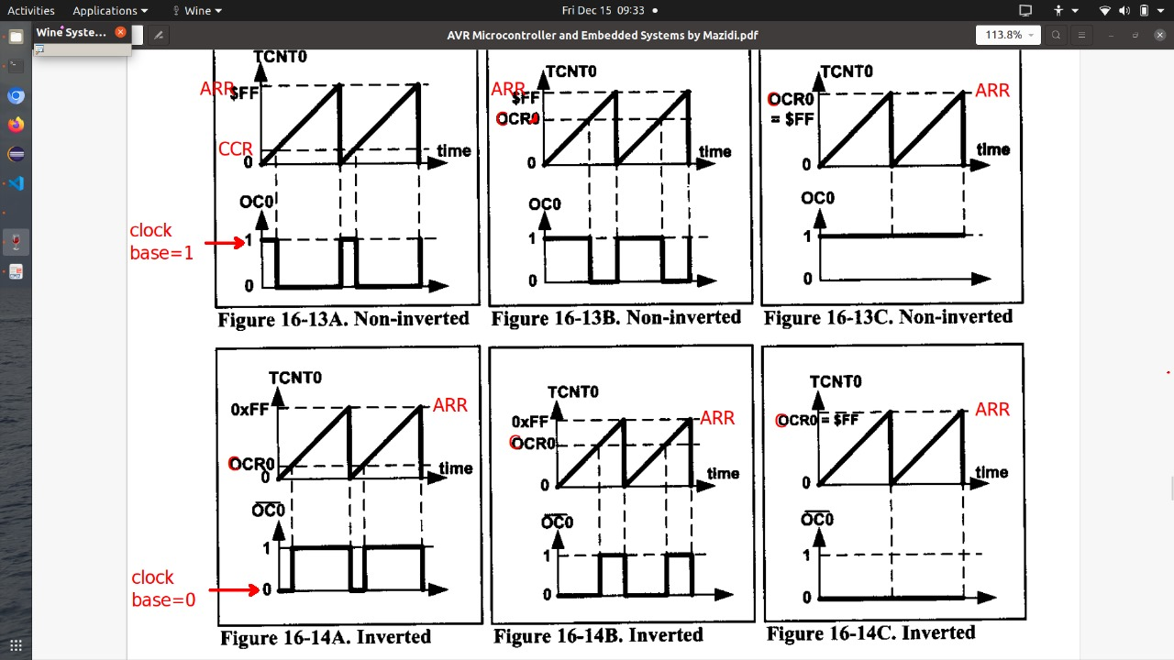

Slide 19
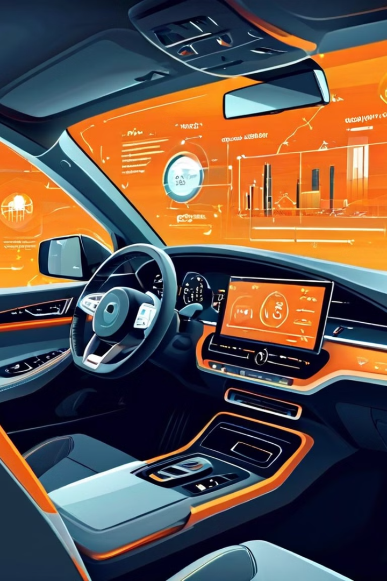
Benefits of Vehicle Automation
1
Improved Safety
2
Enhanced Comfort
3
Increased Efficiency
4
Environmental Impact

Slide 20
Future Scope
1. Integration with Renewable Energy
2.Improved User Interface
3.Global Positioning and Navigation.
4.Enhanced IoT Connectivity.

Slide 21
Challenges and Considerations
Cybersecurity
Integration Complexity
Data Privacy
Robust security measures are needed to protect vehicle systems from cyber threats and unauthorized access.
Seamless integration of CAN bus and IoT technologies requires careful system design and testing.
Safeguarding user data and ensuring compliance with regulations is crucial for vehicle automation systems.

Slide 22
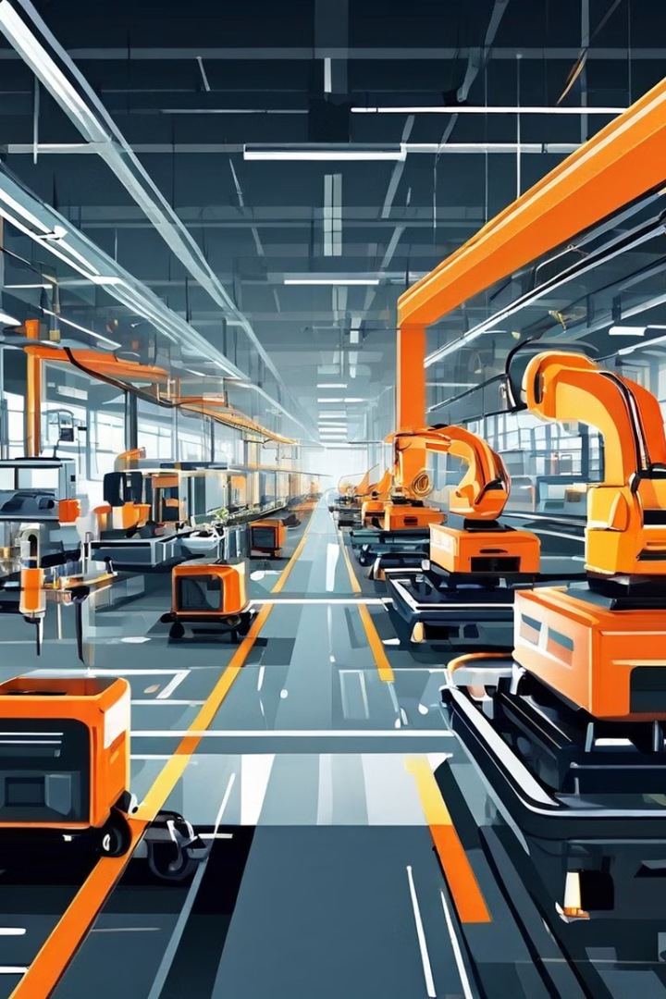
Conclusion and Next Steps
1
Pilot Projects
Implement CAN and IoT-based automation features in selected vehicle models to gather real-world insights and user feedback.
2
Standardization
Engage with industry bodies to develop common guidelines and standards for vehicle automation systems.
3
Scalable Deployment
Refine the technology and integrate it into a wider range of vehicle models to enable widespread adoption.

